Slide 1

Carbon Positive e-car
Making a net positive impact on nature by converting one of the biggest source of pollutants today into a clean air/energy producing marvel

Slide 2

College Name
SRM Institute of Science and Technology
Jadavpur University

Slide 3

Team member details

Slide 4
TEAM MEMBER 1
NAME Santhosh Kumar. R.
EMAIL ID klt.santhosh2002@gmail.com
DISCIPLINE Electronics and Communication Engineering
YEAR 3rd year
MOBILE 9677867812

Slide 5
TEAM MEMBER 2
NAME Pushpal Das
EMAIL ID pushpaldas2001@gmail.com
DISCIPLINE Electronics and Telecommunication
Engineering
YEAR 3rd year
MOBILE 8910497557

Slide 6
TEAM MEMBER 3
NAME Abhishek Sarkar
EMAIL ID abhisrkr007@gmail.com
DISCIPLINE Electronics and Telecommunication
Engineering
YEAR 3rd year
MOBILE 6290782054

Slide 7
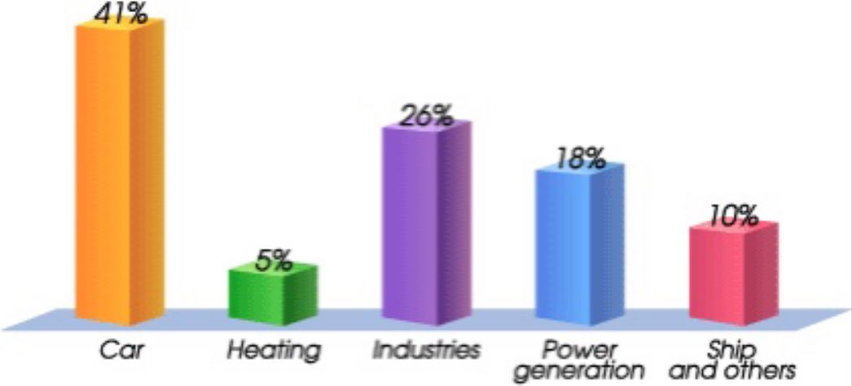
ABSTRACT
The main objective of our team is to make a carbon positive impact to nature through a medium, an electric car. Driving in urban areas with your windows down or your ventilation system set to bring air in from outside can lead to high particulate pollution levels in your car, according to a 2016 study in Environmental Science & Impacts.
These airborne particles have been linked to poor health, such as respiratory illnesses and cardiovascular disease. Carbon dioxide, a key greenhouse gas that drives global climate change, continues to rise every month. By trapping heat from the sun, greenhouse gases have kept Earth's climate habitable for humans and millions of other species. But those gases are now out of balance and threaten to change drastically which living things can survive on this planet and were.

Slide 8
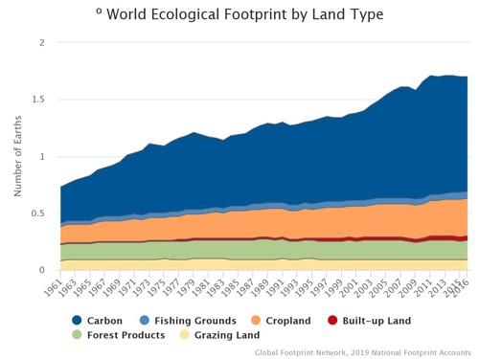
PROBLEM STATEMENT/ CHALLENGES
Carbon dioxide is the primary greenhouse gas, responsible for about three-quarters of emissions. It can linger in the atmosphere for thousands of years. In 2018, carbon dioxide levels reached 411 parts per million at Hawaii's Mauna Loa Atmospheric Baseline Observatory, the highest monthly average ever recorded.
Climate change and the Carbon Footprint Network

Slide 9
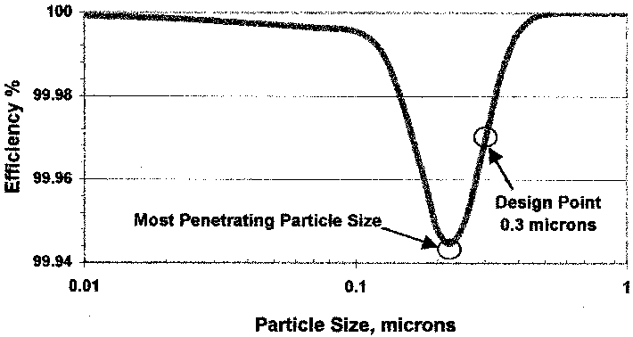
SOLUTION
Our team came up with a solution for eliminating carbon present in the environment and to reduce the global warming by making a hybrid electric car which is made up of solar panels in the roof tops and in addition that car consists of a cylindrical turbine which generates electricity while car starts moving.
The electrical energy generated by these sources will be stored and it is used for moving the vehicle. This reduces the dependency on the fuels which leads to release of carbon traces in the environment. And in addition, Carbon Positive e-car had special filter chambers which consists of HEPA filter and CARBON filter in which the atmospheric air (polluted air) is given as input and after passing it to the filtering chambers the fresh purified air is released in the atmosphere. Which means our Carbon Positive e-car is using renewable source of energy for transporting and it is being self-responsible for cleaning the environment by purifying the air surrounding it and, thereby, making additional 'positive' or 'net export' contributions to nature.

Slide 10
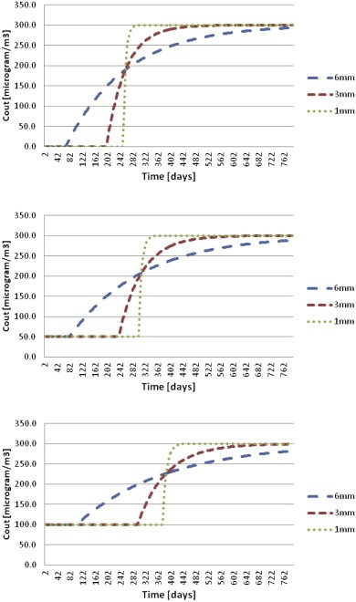
SOLUTION
If we want to decrease your personal impact on the environment through transport, then an EV is the way forward. The electric engine within an EV operates on a closed circuit, so an electric car does not emit any of the gases often associated with global warming. No petrol or diesel is needed in a fully electric vehicle, which is great for your carbon footprint. Even better - if you change your electric car at home, and your home runs on renewable energy from Good Energy, then your carbon footprint shrinks dramatically!
We know that Carbon filters trap odours through a process called adsorption, which occurs when molecules attach to the outside of a surface, rather than being soaked into it (that’s absorption). We join the contrast from renewable source of energy to an electric car, which is designed with air purification module and structure enough to make a clear path of fresh air whenever the electric car is travelling from one point to another. When cars have been one of the major air pollution problem these days, it is time we pay a price to the environment, rather making it happen in the reverse way, a track to the future and sustainable enough for the environment.

Slide 11
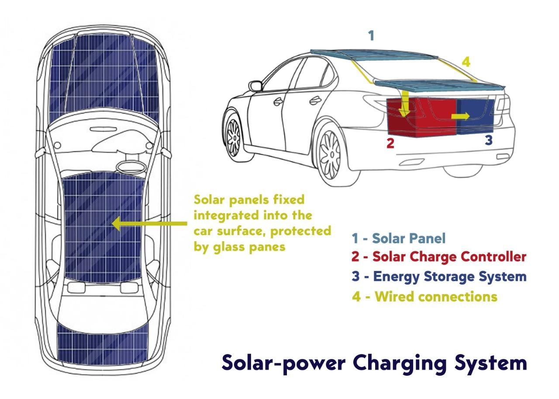
WORKING MODEL

Slide 12
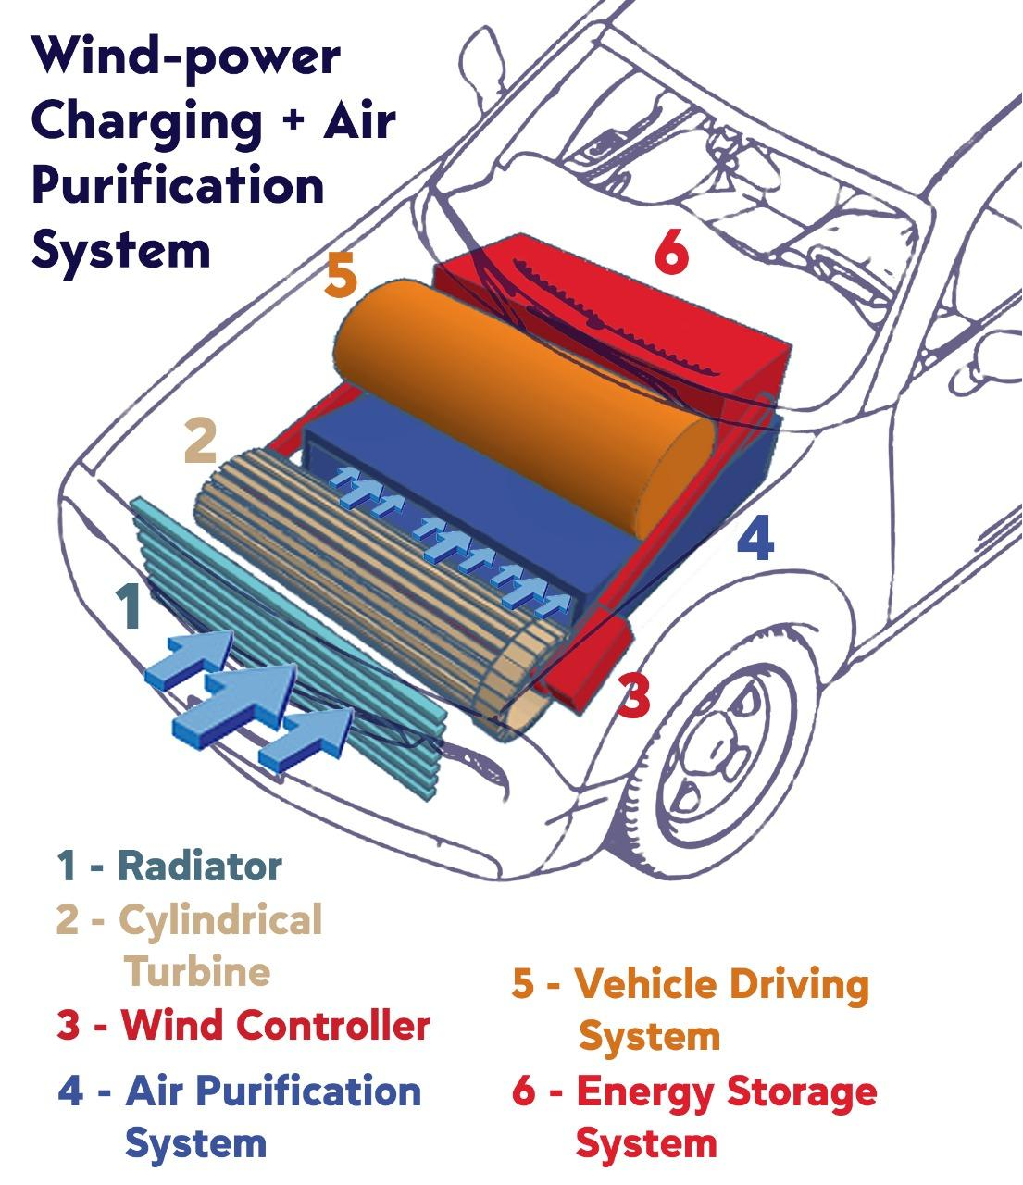
WORKING MODEL

Slide 13
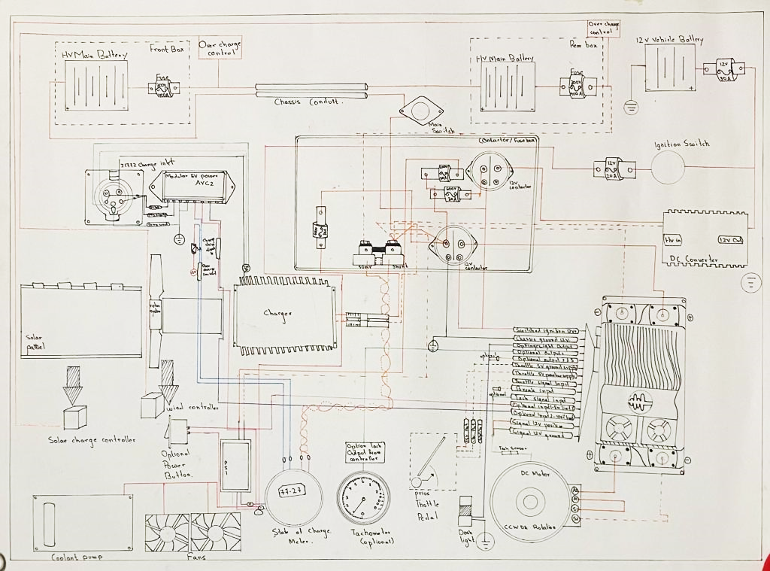
SYSTEM DIAGRAM

Slide 14
SYSTEM
LOGIC
COMPONENTS NEEDED
EV fuses
Chassis
Contactor
Proximity pilot
Ignition Switch
Modular EV Power AVC2
EV Shunt
DC converter
Charging inlet
The Photovoltaic System
Wind turbine
DC motor
PID controller
Coolant pumps and fans
Prius throttle pedal
State of char
Modular EV Power AVC2
State of charge meter
Tachometer
Optional power button

Slide 15
SYSTEM
LOGIC
EV fuses
High power and 1000Vdc fuses; Faster charging, increased vehicle range, and premium systems.
High interrupting rating protects high capacity battery packs with increased power levels.
Chassis
Determines the tire positions and to absorb shocks from the road surface.
Contactor
A contactor is an electrical device which is used for switching an electrical circuit on or off. It is considered to be a special type of relay
Proximity pilot
The Proximity Pilot (PP) checks if the vehicle connector is connected properly to the vehicle inlet. If the connection is not properly established, the Proximity Pilot will detect it, and the entire process will be disabled for safety.

Slide 16
SYSTEM
LOGIC
DC converter
The main dc-dc converter changes dc power from an on-board 200-800V high voltage battery into lower dc voltages (48V or 12V) to power headlights, interior lights, wiper and window motors, fans, pumps and many other systems within electric vehicles
Charging inlet
Charging inlets are needed that can handle 10-20 times the power of the current generation of electric cars.
The Photovoltaic System
Solar car depend on PV cells to convert sunlight into electricity to drive electric motors. Unlike solar thermal energy which converts solar energy to heat, PV cells directly convert the sun into electricity.

Slide 17
SYSTEM
LOGIC
Ignition Switch
The ignition switch is a more complex electrical component that has to “read” anti-theft coding in the key before it will activate electrical systems in the vehicle so the vehicle can start or allow an automatic transmission to be shifted out of Park. On vehicles with push-button start, the ignition switch has to recognize the anti-theft code transmitted by the key fob before it will allow the engine to start.
Modular EV Power AVC2
The AVC2 module improves on J1772 pilot communications and power control. It improves safety and compatibility with public J1772 charging stations on converted vehicles.
The adaptor takes advantage of the differing pin lengths to insure ground mates first and breaks last. Pin lengths also insure power pins are mated before the pilot and the pilot ends before the power pins separate.
EV Shunt
A shunt is a very low value calibrated resistor. Its purpose is to measure the current that is passing through it. And they are generally specified by a current and millivolt rating.

Slide 18
SYSTEM
LOGIC
Wind turbine
A wind turbine is mounted on the front of the vehicle to receive wind. The generator produces electricity from the wind and stores them in another battery.
DC motor
Using DC motors have advantages like higher speed ranges, noiseless operation, faster dynamic response, better speed versus torque characteristics etc. Also, the ratio of torque delivered relative to the size of the motor is higher, which makes it a good choice for electric vehicles, where high power is required but lightness and compactness are critical factors as well.
PID controller
A PID control for electric vehicles subject to input armature voltage and angular velocity signal constraints is proposed. ... Also, results demonstrate that a controller subject to constraints can improve the electric vehicle DC motor dynamic; and at the same time it protects the motor from overvoltage.

Slide 19
SYSTEM
LOGIC
Coolant pumps and fans
As the engine speeds up or down, or as the sensor detects heat, the pump pushes coolant around the system and radiator hoses, starting from the engine block, to the cylinder heads, to the radiator and back.
Prius throttle pedal
The accelerator pedal sends a signal to the controller which adjusts the vehicle's speed by changing the frequency of the AC power from the inverter to the motor
Optional power button
To simple start and stop the vehicle's motor by simply pressing the button.
State of charge meter
Determine how much charge is left on the batteries while also accurately measuring the battery voltage.

Slide 20
SYSTEM
LOGIC
Tachometer
It show the rate of rotation of the engine's crankshaft, and typically have markings indicating a safe range of rotation speeds. This can assist the driver in selecting appropriate throttle and gear settings for the driving conditions.
Modular EV Power AVC2
The AVC2 module improves on J1772 pilot communications and power control. It improves safety and compatibility with public J1772 charging stations on converted vehicles.
The adaptor takes advantage of the differing pin lengths to insure ground mates first and breaks last. Pin lengths also insure power pins are mated before the pilot and the pilot ends before the power pins separate.
EV Shunt
A shunt is a very low value calibrated resistor. Its purpose is to measure the current that is passing through it. And they are generally specified by a current and millivolt rating.

Slide 21

Our team have taken analysis of the project report into five major parts:
Define
Design
Implement
Analyze
Share
We define our project as a major part or a revolution to bring a change by the next 10 years of cars polluting the atmosphere. Our goal is to make a payback to the environment by purifying the polluted air, that means we can indirectly say that we can make it happen in the next 10 years that everyone driving an electric vehicle is also responsible for creating a beautiful pollutant free nature among us.
On January 29, 1886, Carl Benz applied for a patent for his “vehicle powered by a gas engine.” The patent – number 37435 – may be regarded as the birth certificate of the automobile. But nobody knew that after 100 years , this invention would lead to a problem in the 21st century we live in and create a major issue for polluting the air around.
ANALYSIS

Slide 22
We designed our model of EV as a environmental friendly Carbon Positive e-car, having its source of energy as a renewable source of energy. A car which is made to eliminate pollutants from the chambers present in the radiator of the car. We have three charging inputs in our Carbon Positive e-car, one is from solar photo voltaic system, another one is from horizontal designed turbines and the third we kept as a backup for when the car is standing with no charge, an external charging input.
The Carbon Positive e-car can run at its own pace while charging it’s batteries. When the car is moving, due to motion the air passing towards the turbines present generates electricity thereby transforming wind energy to electrical energy. On the other hand, solar panel acting as a major source of energy can be used to run the vehicle at the same time it can be stored. We can say that the wind energy acting with 25% efficiency and the solar energy with 75%. In any extreme cases, to avoid problems with the user, we have an optional electric charging port where it can be charged externally.
Our main aim is to eliminate pollutants which is possible by the simple flow of air travelling in opposite to the direction of the car. Our model also features a 6 layer air filter which can not only adsorb carbon but also it is very much efficient to dust particles. We have seen an air filtration system inside the car till the date , but what our team is aiming at is purifying it externally, therefore with large number of EV and combustion cars used in today's world, implementing this external system would eventually lead to a healthy environment among us, a pollutant free environment .
ANALYSIS

Slide 23
Implementing the four things we stimulated and have taken in our project that is renewable sources of energy and the process of filtration through a Carbon Positive e-car, we can make any EV be a proper definition of what 21st century sustainable EV assumed and worked as. We have faced numerous problems in our society , environment for air pollution and when it comes to air pollution, car is one of the major causes for it. Implementing our idea can lead to a greener society towards our future of humanity and earth. Carbon being one of the major causes of air pollution, our Carbon Positive e-car is designed in a way that anyone driving the EV will be able to purify its nature around.
EV which is dependant on the nature , works with the renewable sources of energy for the nature with the best driving experience an user can expect. What better can we expect when it comes to sustainability and a car? Keeping our analysis we can say that with the usage of Carbon Positive e-car the pollution level present in the atmospheric level will be decreased and it will reduce the dependency on the non-renewable fuels and reduces the global warming level and it will bring the awareness among the people about the ecosystem and it will make the people be responsible for cleaning the environment pollutants. The usage of this Carbon Positive e-car can show us the purifying of the society and how it makes environment clean.
ANALYSIS

Slide 24
ENDING
WORDS
Lastly our team would like to thank Aarush, the jury present, the whole team who have made the Hybrid Hack possible and made a platform for us to prove our technology, Carbon Positive e-car , our way of dealing with environment and making it a target to make it sustainable in the future days. We believe for a better future in sustainability where Carbon Positive e-car is working through renewable sources and finding a medium as an EV, thereby eliminating carbon and making a pollutant free nature.

Slide 25
REFERENCES
https://www.thehealthy.com/allergies/car-air-purifier/
https://www.frontiersin.org/articles/10.3389/fpubh.2020.00014/full
https://www.epa.gov/air-research/air-quality-and-climate-change-research
https://www.nationalgeographic.com/environment/article/greenhouse-gases
Xue Dong 2021 IOP Conf. Ser.: Earth Environ. Sci. 632 052095
L. Battisti et al 2016 J. Phys.: Conf. Ser. 753 062009
Nagarajan, C. & M, Muruganandam & Ramasubramanian, D.. (2012). Analysis and Design of CLL Resonant Converter for Solar Panel-battery Systems. International Journal of Intelligent Systems and Applications. 5. 52-58. 10.5815/ijisa.2013.01.05.
EV West - AC-51/76 Curtis 1239 Hall / Prius Throttle Schematic
Notes:
‹#›

